Slide 1

Zen Routing
Justin Lewis
Pablo Dominguez
Faculty: Dr. Jean-Francois Chamberland
Texas A&M University

Slide 2
Outline:
Introduction
Methods
Results
Discussion

Slide 3
I. Introduction:

Slide 4


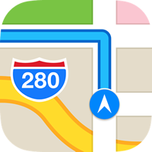
Relevant Problem:
Daily commutes and driving in general is highly stressful
Current routing applications do not directly account for driver’s well-being / overall stress

Slide 5
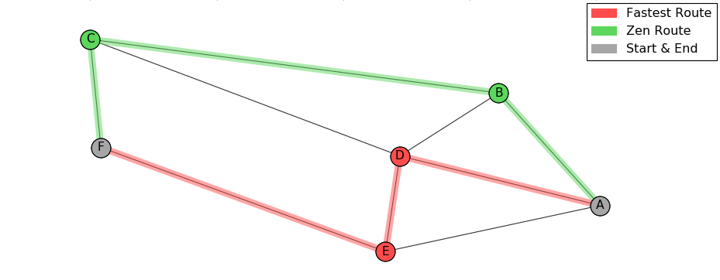

Zen Routing Concept:
Provide individuals with alternative traveling routes which are comparable with the fastest route but are less stressful

Slide 6
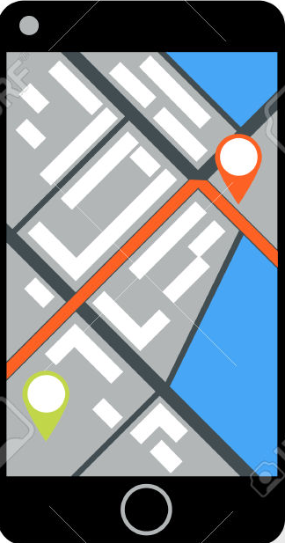
Project Framework:
Purpose: stress-sensitive routing
Key Components:
Roadway model
Route Zenness
Optimal path choice
User feedback

Slide 7
II. Methods:

Slide 8
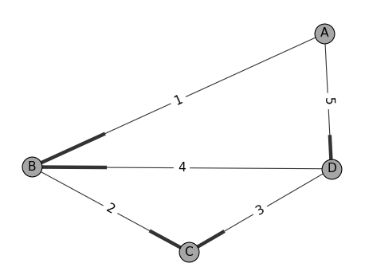






Roadway Model
Directed Network Graph
Nodes$\overset{⃑}{N}$
Edges$\overset{⃑}{E}$
Graph $G\left(\overset{⃑}{N},\overset{⃑}{E}\right)$
Edge $E\left(N_{A} , N_{B}\right)$
Node $N_{A}$
Edge Weight:

Slide 9
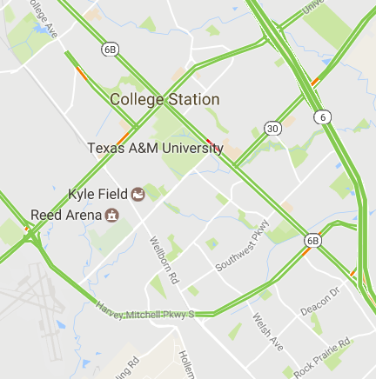
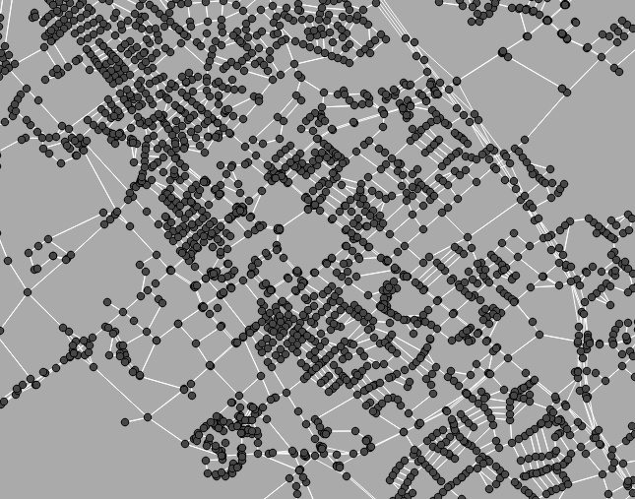
Our Network Graph:
Nodes viewed as intersections
Road segments as directed edges

Slide 10
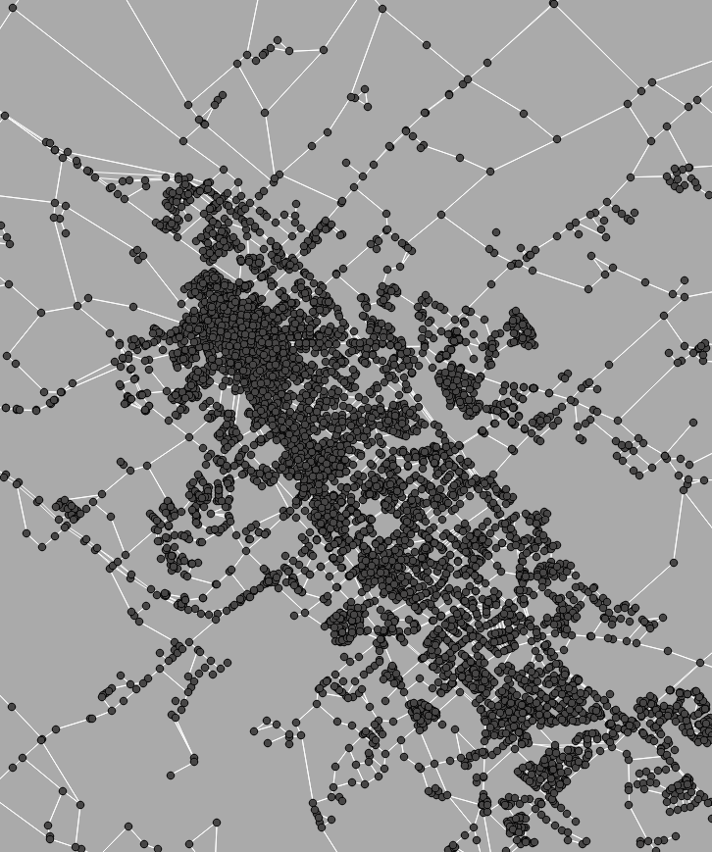
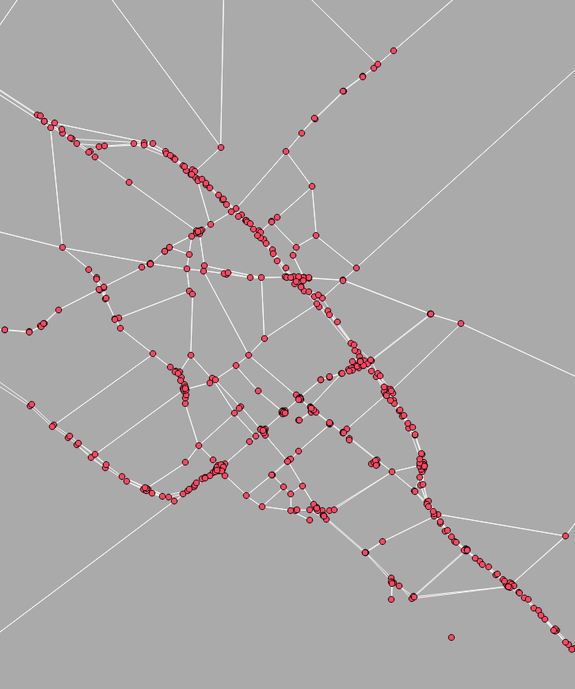
Network Reduction:

Slide 11
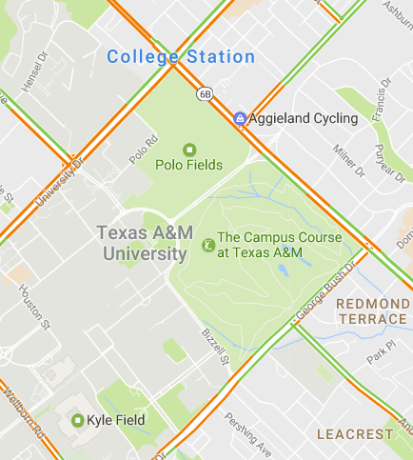
Driving Zen Factors :
Generalized:
Traffic congestion
Route variability
Route comfortability

Slide 12

Zenness Metric
$$Zen Score= \ln\left(1+\frac{t_{current} −{ t}_{base}}{t_{base}}\right)∙d_{segment}$$
Note: smaller Zen Scores <=> less stressful

Slide 13



Congestion Data Source
Obtained indirectly from Google Maps API services
Uncongested time => $t_{base}$
Current time => $t_{current}$
Added trip time correlated with traffic congestion
$$t_{current} −{ t}_{base}$$

Slide 14
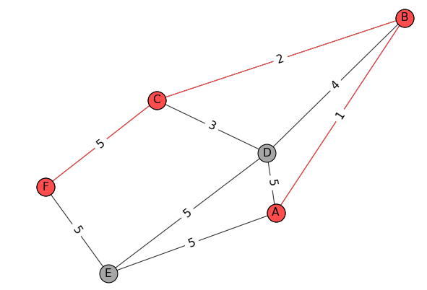

Optimal Path Choice
Dijkstra's Algorithm:
Edge Weight:
Finds shortest path which minimizes sum of weight

Slide 15

Multi-Objective Optimization:
Chosen objectives:
Driving time
Zenness
Issues:
Factor tradeoff
Dijkstra’s Algorithm
VS.

Slide 16




Multi-Objective Solution:
Objective reduction
Start : multi-objective
End : single objective
Weighted sum of factors
Defines new single objective
$$w_{time}$$
$$w_{zen}$$
$$Given path P_{i} , path factors \overset{⃑}{f}\left(P_{i}\right)$$
$$W\left(P_{i}\right)=\sum_{all k}{f_{k}\left(P_{i}\right)∙w_{k}}$$
$$\sum_{all k}{w_{k}=1}$$
+
$$w_{total}$$

Slide 17


User Factor Weights
Define individual route preferences
Factor weights => factor relevance
Experimentally inferred
$$\overset{⃑}{w}=\left\{w_{time} , w_{zen} ,…\right\}$$

Slide 18


User Feedback:
Statistical inference of user weights
Logistic regression
$$\overset{⃑}{w}=\left\{w_{time} , w_{zen} ,…\right\}$$
Zen Route

Slide 19
Methods Review
Traffic
Network Graph
Ideal
Path
Shortest Path
Algorithm
User Weights
User Feedback

Slide 20
III. Results:

Slide 21
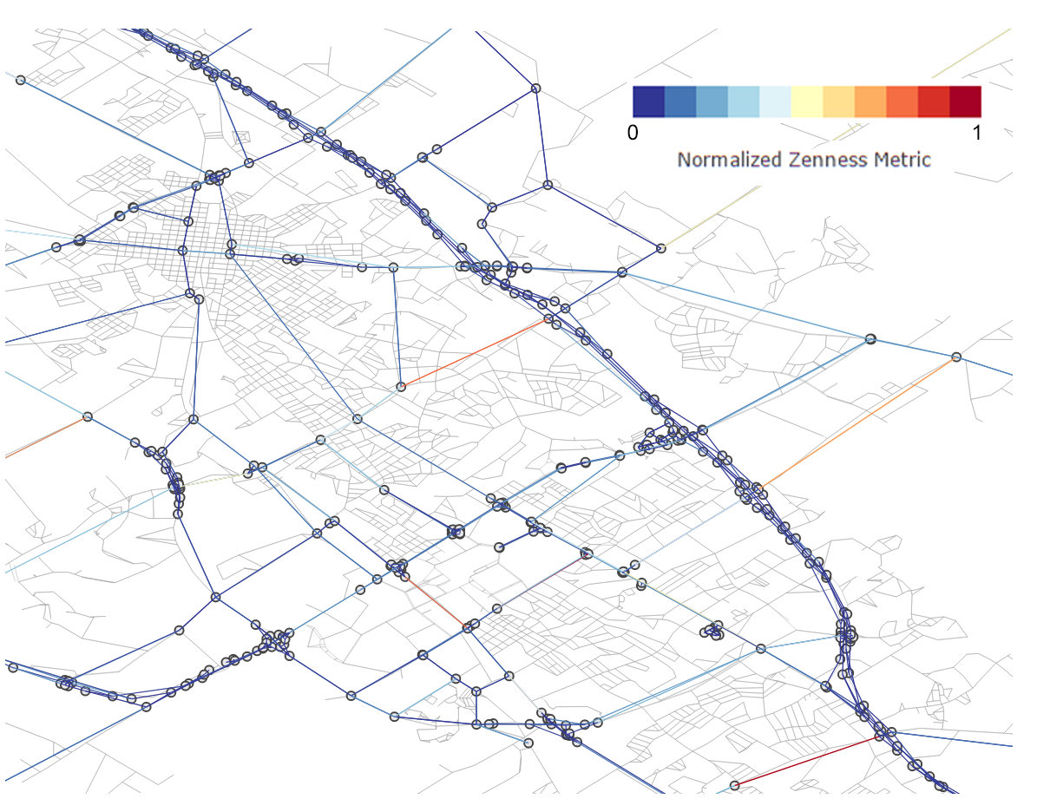
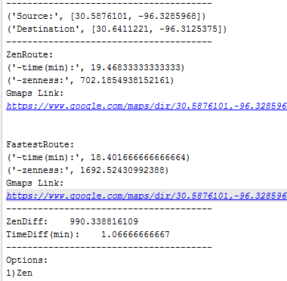
Zen Score Analysis:

Slide 22
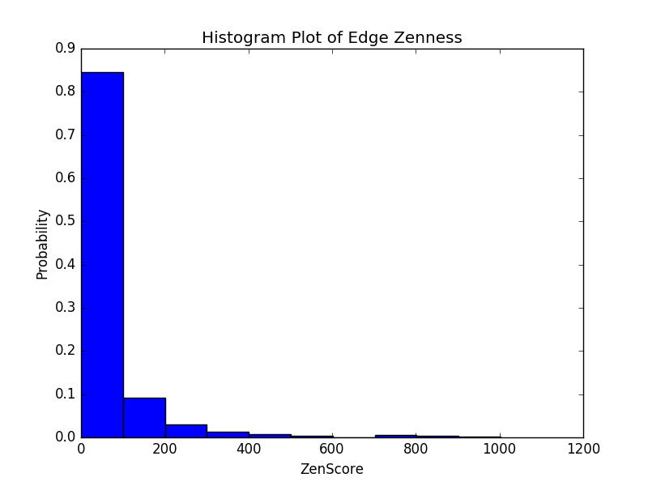
Zen Score Analysis:

Slide 23
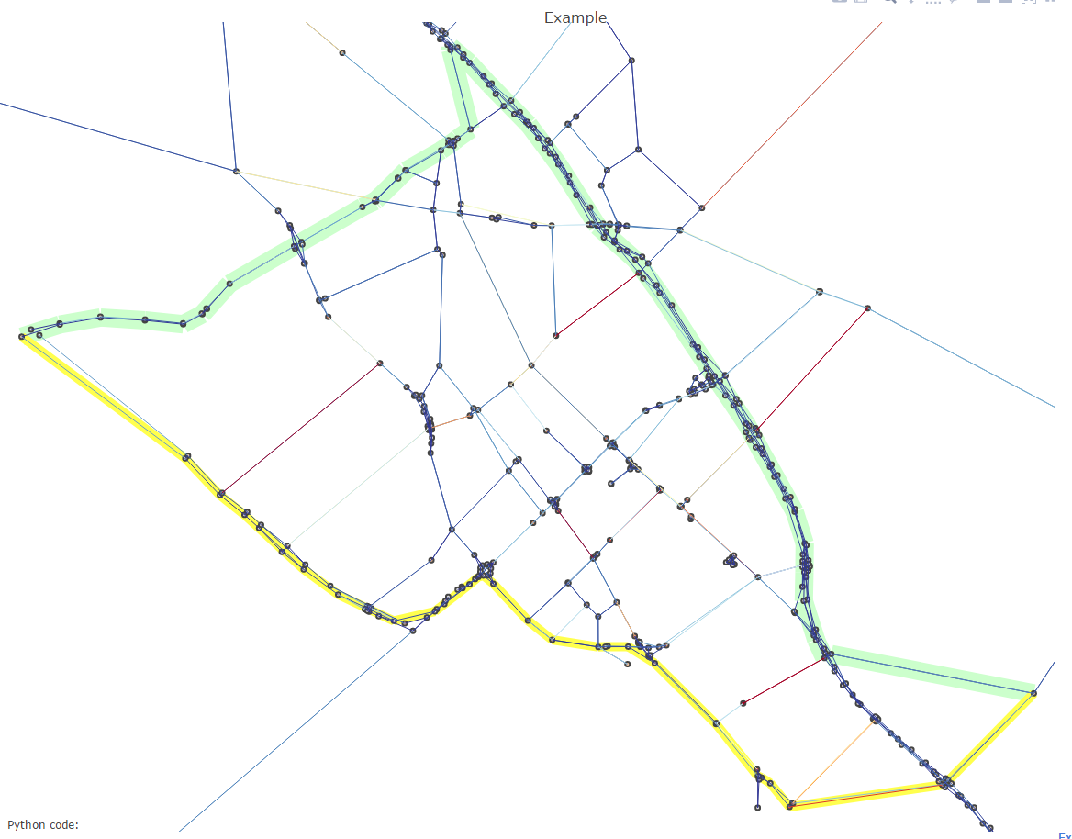

Real World Example:
 | Zen Route | Fastest Route
Time (min): | 27.2 | 27.1
Zen Score: | 964 | 1500

Slide 24
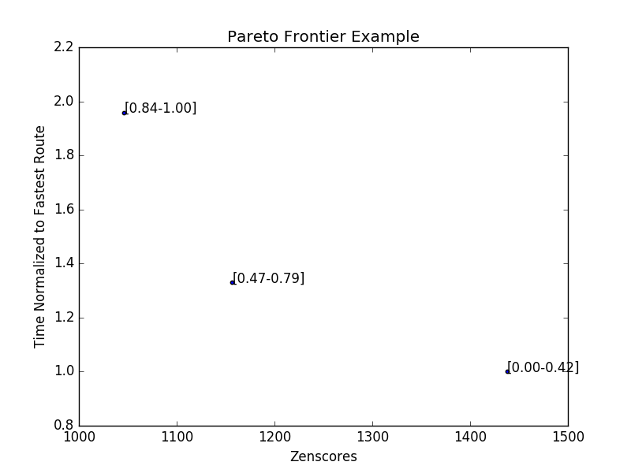

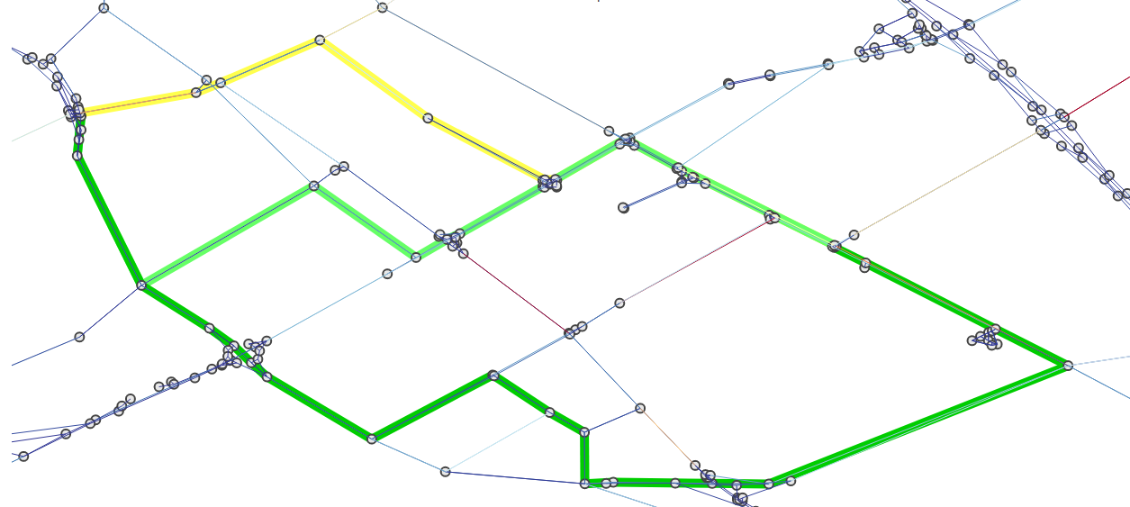
Pareto Optimality:

Slide 25
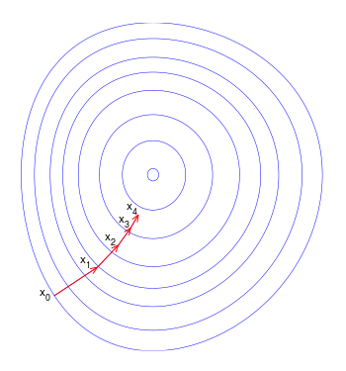
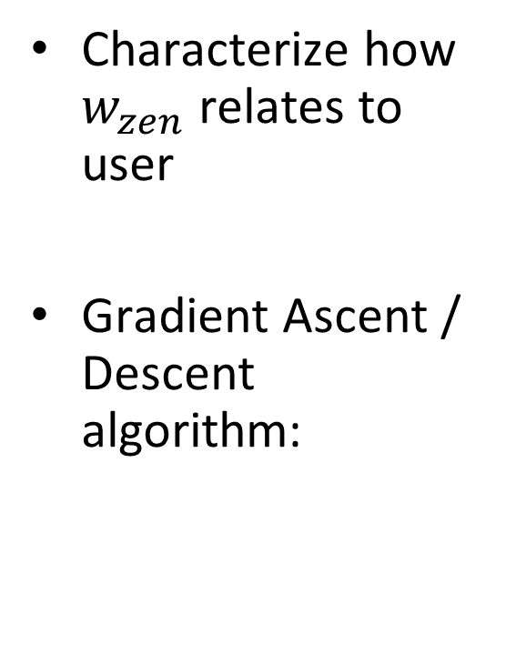
User Weight Estimation:
Characterize how $w_{zen}$ relates to user
Gradient Ascent / Descent algorithm:

Slide 26


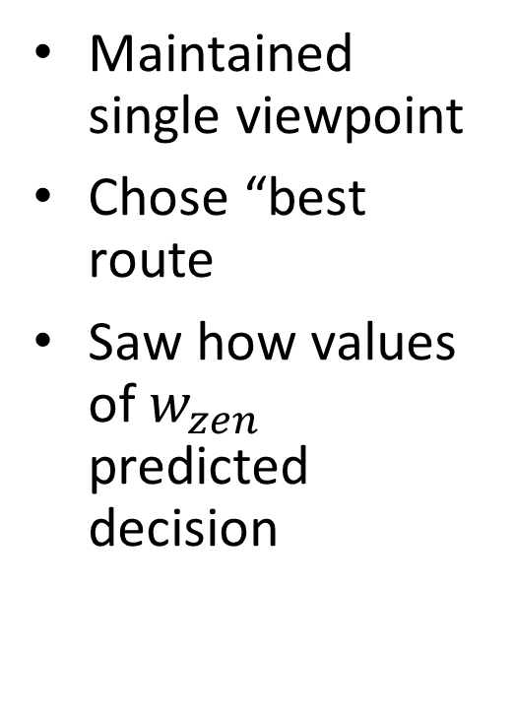
$w_{zen}$ Characterization:
Maintained single viewpoint
Chose “best route
Saw how values of $w_{zen}$ predicted decision
Ranges $w_{zen}$

Slide 27
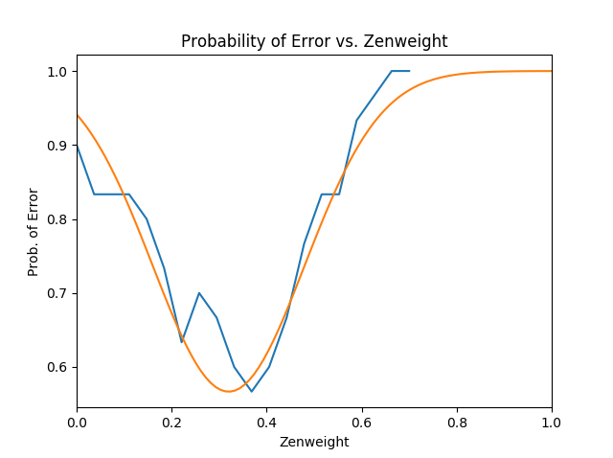
User Weight Estimation:

Slide 28
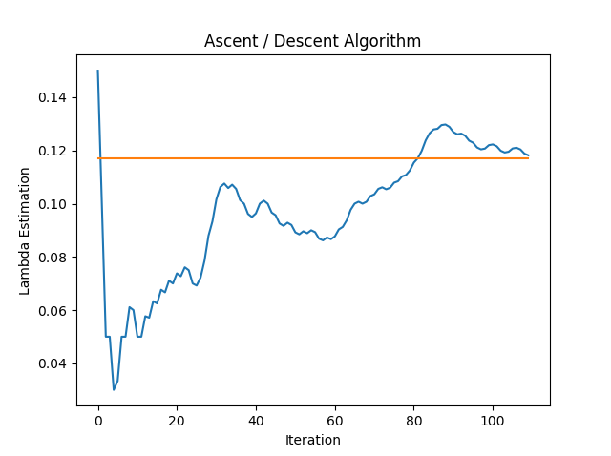
User Weight Estimation:

Slide 29
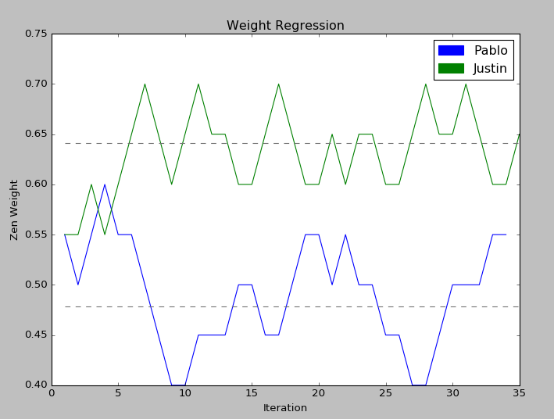
User Weight Estimation :

Slide 30
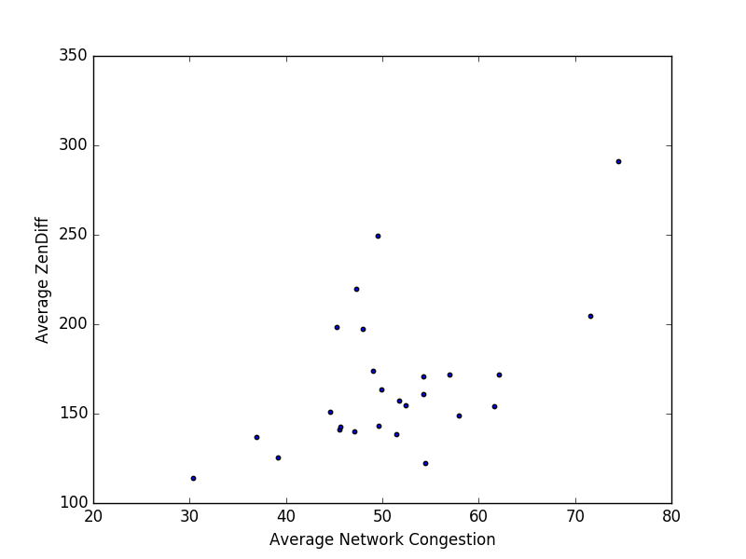
Zen Relevance:
Under what network conditions is the Zen route
most appealing?

Slide 31
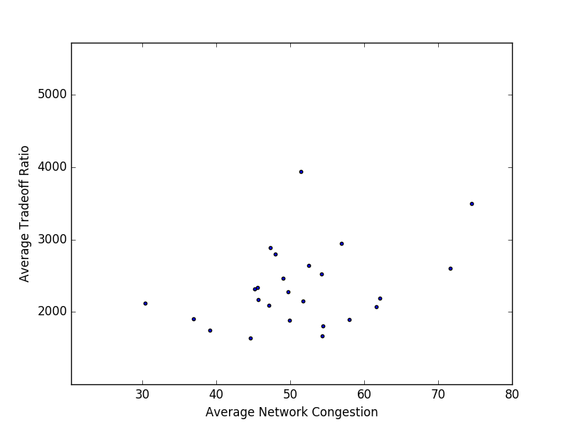
Zen Relevance:
Under what network conditions is the Zen route
most appealing?

Slide 32
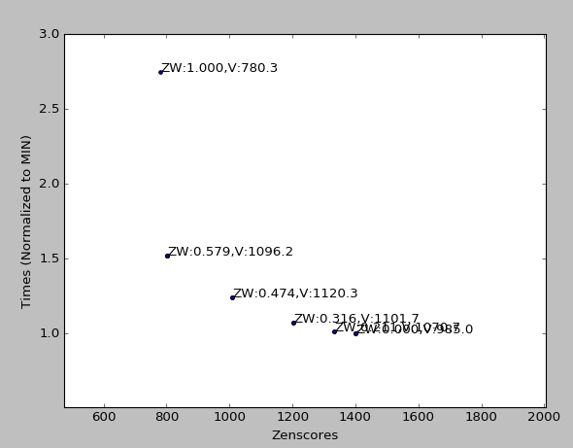
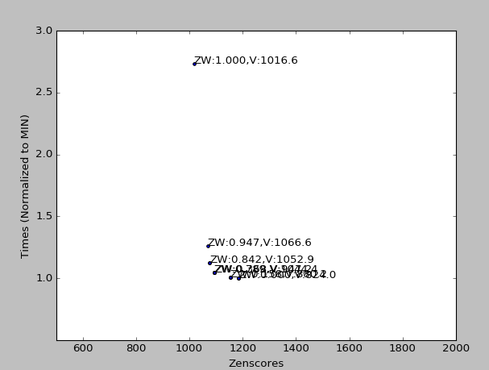
Pareto Optimality:
Curve shape could lead to better characterization

Slide 33
IV. Discussion:

Slide 34
Framework Applications:
Potential users:
Student drivers
Visitors / Tourists
Everyday people
Other potential path factors:
Safety
Scenery

Slide 35
End

Slide 36
Picture Sources:
Company logos:
http://logos.wikia.com
Map snippets:
https://www.google.com/maps
Miscellaneous icons:
Zen symbol- www.zazzle.com
Phone- es.123rf.com
Thumbs up and down- www.dreamstime.com

